Slide 1
Product Search NLP Evaluation
Christine Xu
Shio Huang
Yishi Wang
Lucy Xu

Slide 2
Table of contents
01
02
03
04
05
06
Problem Statement
Baseline Pipeline & Tagging Model
Multi-Agent Query-Time Enrichment
Pre-Tagging Enrichment
Claim-Level Evaluation & Insights
Recommendations & Future Work

Slide 3
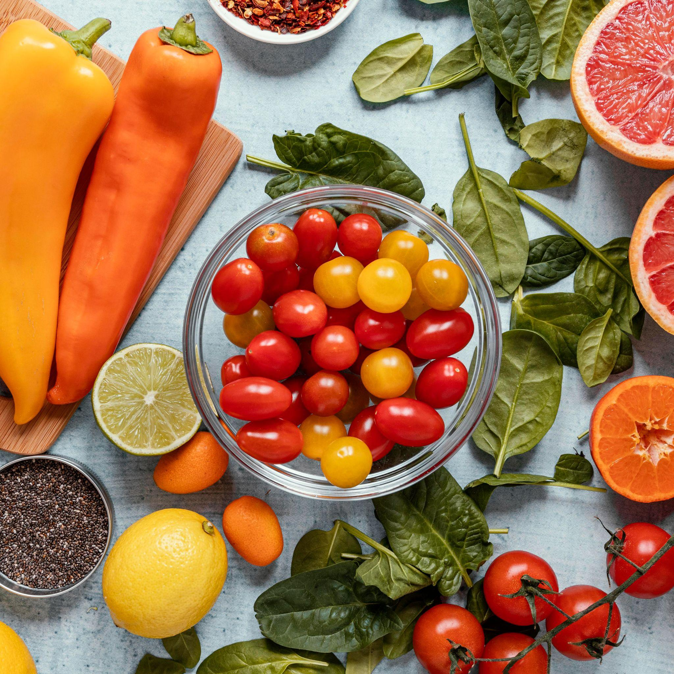
Problem Statement:
Why Natural-Language Product Search Is Difficult
The product search task in GNPD is challenging because:
User intent is expressed in free text: “eco packaging”, “paraben free”, “blueberry high-protein yogurt” do not map cleanly to GNPD’s categories, claims, or ingredient fields.
Product Language is inconsistent and unstandardized: “environmentally friendly”, “paraben-free”, “illuminating formula”
Model need clean, structured signals to perform well: LLMs and embedding models perform better when products have normalized attributes.
Our Goal: Build a scalable and accurate natural-language product search system for GNPD by aligning user intent with heterogeneous product data through preprocessing, enrichment, tagging, embedding models, and LLM-based evaluation so users can retrieve relevant products without relying on GNPD’s internal taxonomy.

Slide 4
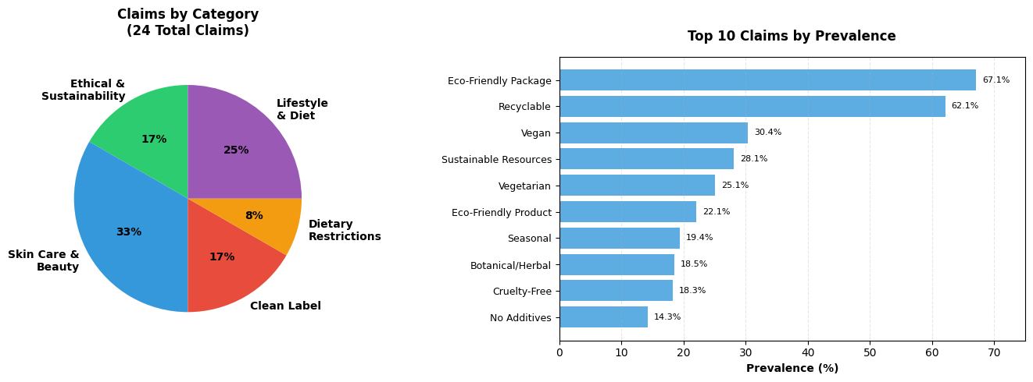
Product Claims Distribution
Total Unique Claims: 150+
Evaluated Claims: 24 claims across 5 categories (>5% prevalence, >238 products each)
Category | # Claims | Example Claims
Dietary Restrictions | 2 | Gluten Free, Low Allergen
Lifestyle & Diet | 3 | Vegan, Vegetarian, Organic
Clean Label | 4 | No Additives, No Artificial Colors/Flavors, Sugar Free
Ethical & Sustainability | 4 | Recyclable, Eco-Friendly, Cruelty-Free, Sustainable
Nutritional Fortification | 1 | Vitamin/Mineral Fortified
Personal Care | 2 | Paraben Free, For Sensitive Skin
Specialty | 8 | Seasonal, Botanical, Moisturizing, Anti-Aging, Premium

Slide 5
Building Ground Truth from Claims
Focus on 24 high-prevalence claims (>5% prevalence, >238 products each)
Generate 50 natural language queries with 2-4 variations per claim
Balanced Set: 50/50 positive/negative (200+200 per query)
Example:
Combined Claims Strategy:
Claim
"Vegan/No Animal Ingredients"
"Sugar Free/No Added/Low Sugar" combines:
- "Sugar Free" (65 products)
- "No Added Sugar" (116 products)
- "Low/Reduced Sugar" (63 products)
→ Total: 244 products (UNION)
Evaluation Queries
- "vegan"
- "no animal ingredients"
- "100% plant-based"

Slide 6
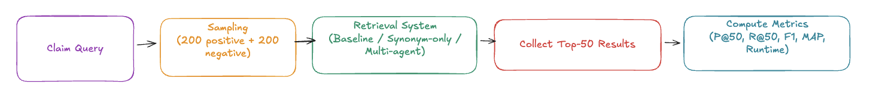
Metrics & Evaluation Design (Query‑Time Enrichment)
1. Conditions compared
Use three query-processing strategies:
Baseline (no enrichment）
Synonym-only (lexical variants）
Full multi-agent system (synonym + domain + semantic + fusion）
2. Dataset & Sampling
We validate across real claim categories:
50 claims across sustainability, ingredients, botanical, beauty, etc.
Balanced sampling:
400 products per claim (200 positive + 200 negative
3. Metrics @k = 50
We evaluate how well each system retrieves relevant products:
Precision@50: how clean the top 50 results are
Recall@50: how many relevant items are covered
F1@50: balanced precision/recall
MAP@50: how early relevant items appear in ranking
Runtime: cost & scalability of query-time enrichment

Slide 7
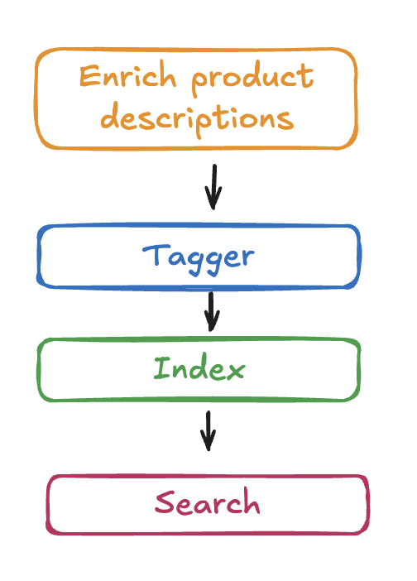
Keyword Extraction with KeyBERT
Pre-tagging
Enrich the product descriptions before tagging and indexing
Why KeyBERT
Converts long product descriptions into clean, representative keywords
Uses BERT sentence embeddings to capture semantic meaning
How It Works
Generate document embedding with Sentence-BERT
Create candidate phrases and rank them by cosine similarity
Select top-N phrases as product keywords
Benefits
Produces consistent, high-quality tags for search and retrieval
Improves BM25 + embedding hybrid search performance
Automates metadata enrichment at scale
Example
“Organic vanilla yogurt… gluten-free, low sugar” →
organic, vanilla yogurt, gluten free, low sugar

Slide 8
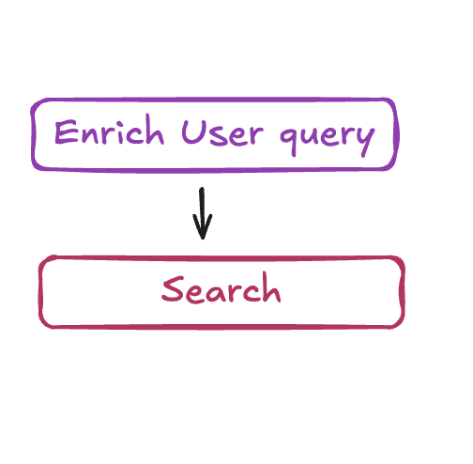
Where Enrichment Sits
Query-time enrichment(A)
Enrich the user query before search
Pre-tagging enrichment(B)
Enrich the product descriptions before tagging and indexing

Slide 9
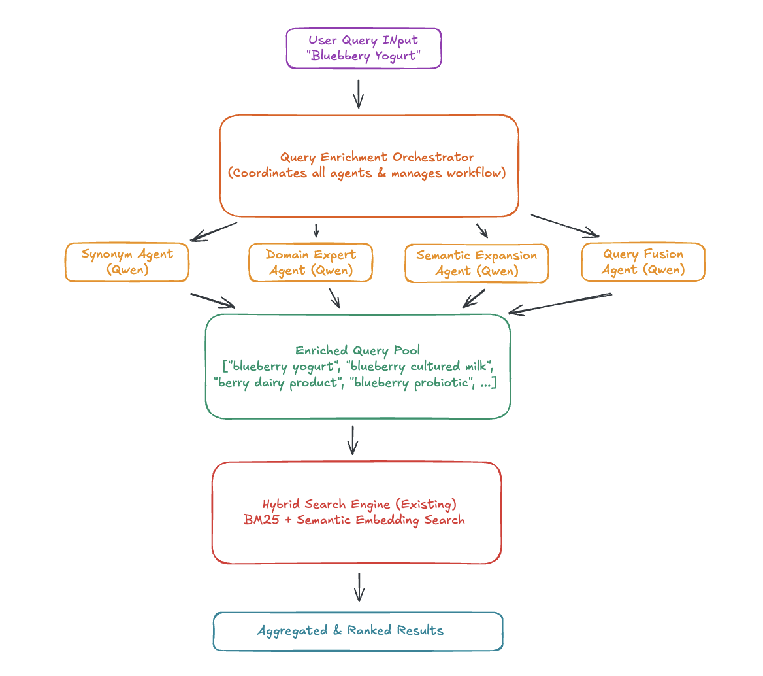
How Current Enrichment Works (Multi‑Agent System)
A specialized multi-agent system expands queries in controlled ways to improve coverage while limiting semantic drift
Query-Time Pipeline
User Query
Synonym Agent (lexical variants)
Domain Expert Agent (label/certification language)
Semantic Expansion Agent (paraphrases / conceptual neighbors)
Fusion Agent (rank + select best candidates)
Enriched Query Set
Hybrid Retrieval (BM25 + embeddings) → Top‑k results
Important: Enrichment produces a small, curated set of candidate queries rather than a large uncontrolled list, balancing coverage and relevance.

Slide 10
Query-Time Results (K=50)
What we see
Full enrichment retrieves slightly more relevant results (Recall/F1).
Early ranking quality drops (MAP).
Runtime jumps from 17.5 → 205.7 sec (more than 10×).
What it means
Vocabulary expansion helps recall, but introduces drift.
Large runtime cost makes query-time enrichment impractical for large-scale search.

Slide 11
Claim-Level Insights: Where Enrichment Helps (and Where It Hurts)
A. Winners: Where Enrichment Helps
(Vocabulary expansion aligns well with product descriptions)
Environmentally Friendly Product: 0.008 → 0.040 (+400 percent)
Reason: Captures "eco-friendly", "green", "sustainable"
Sustainable Resources: 0.024 → 0.048 (+100 percent)
Reason: Adds "sustainably sourced", "renewable materials"
Paraben Free: 0.043 → 0.064 (+49 percent)
Reason: Handles “paraben-free”, “no parabens”, “without parabens”
Botanical / Herbal: 0.040 → 0.056 (+40 percent)
Reason: Adds common botanical keywords
Moisturising / Hydrating: 0.144 → 0.160 (+11 percent)
Reason: Stable synonym space, low drift risk
Pattern: Works best for broad, descriptive, positive claims.
B. Losers: Where Enrichment Hurts
(Strict or negation-based claims suffer from drift)
Free from Artificial Colourings: 0.064 → 0.024 (–62 percent)
No Additives / Preservatives: 0.056 → 0.040 (–29 percent)
Vegan / No Animal Ingredients: 0.056 → 0.048 (–14 percent)
Why these fail
Semantic drift: “natural coloring” ≠ “no artificial coloring”
Over-generalization: “plant-based” not always vegan
Fusion dilution: weak expansions leak into final enriched set
Pattern: Constraint / negation claims are fragile.
C. Synonym-only: Too Noisy Without Domain Rules
(Mixed impact depending on claim type)
Helps: Organic, Antioxidant, Botanical / Herbal
Hurts: Brightening / Illuminating, Ethical: Animal, Ethical: Recycling
Why?
Synonym-only methods generate non-standard, domain-incorrect, or overly broad terms
No guardrails → precision drop
Pattern: Synonyms alone are unstable and inconsistent.
Employer 3

Slide 12
Main Diagnosis: Vocabulary Mismatch Between Query & Index
The enriched query vocabulary does not exist in the tagging index. This creates misalignment and limits the benefit of enrichment.
A. What actually happens
Enrichment expands the user query, but the search index relies on tags generated from original product descriptions. Since tag vocabulary is much smaller, enriched expansions often have no matching tag, leading to poor alignment.
B. Mismatch example
Component | Text
Product text | “environmentally friendly packaging”
Baseline tags | packaging green
Enriched query | “eco-friendly”, “sustainable”, “renewable”
Problem | None of these enriched tokens exist in tag vocabulary → retrieval drifts

Slide 13
Test: Enrichment Before Tagging (Pre‑Tagging Enrichment for 500 samples)
Step 1
Step 2
Step 3
Step 4
Product Description
Enrichment
KeyBERT Tagging
Search Index User Query (original)
Vocabulary expansion result
Enrichment is applied before the tagger, so the indexing vocabulary grows:
Original tag vocabulary: 3,247 unique tags
Enriched tag vocabulary: 5,891 unique tags
Total expansion: +81.4 percent
Step 5
Step 6
Search
Top-K result

Slide 14
Performance Comparison @ K = 50 Metrics
Metric @50 | Improvement | % Change
Precision@50 | +0.0637 | +35.1 percent
Recall@50 | +0.0164 | +36.6 percent
F1@50 | +0.0259 | +36.1 percent
Why This Is Decisive
Fixes the mismatch: enriched vocabulary is now in the index, so enriched queries align with searchable tags.=
Quality jumps: Precision, Recall, and F1 all improve by about 35 percent.
No latency cost: LLM enrichment happens offline once, not during query-time.
Scalable: Works for millions of products because enrichment is precomputed.
Conclusion: Pre-tagging enrichment delivers substantially better retrieval and is production-viable, unlike query-time enrichment.

Slide 15
Future Direction (What We Recommend)
1. Strengthen Product Data Normalization and Preprocessing
Cleaning and standardizing OCR text, descriptions, and structured fields improves all downstream methods.
Reduce noise in OCR text
Normalize claims, ingredients, and packaging language
Standardize metadata formats
Purpose: Provide models with consistent, high-quality signals.
2. Use Query-Time Enrichment Only as a Selective Fallback
Query-time LLM enrichment can help, but should not be the default due to latency and drift.
Baseline retrieval is sparse or low-confidence
Claims historically benefit from vocabulary expansion (for example, sustainability, botanical, ingredient-heavy queries)
Purpose: Improve recall in specific cases without incurring system-wide cost.
3. Add Claim-Aware Routing & Guardrails
Some claims are fragile, especially negation or constraint-based ones, so LLM expansions must be controlled.
Negation detection (“no X”, “free from X”) → block risky semantic expansions
Similarity thresholds + formatting rules to avoid drift
Downweight drift-prone expansions during fusion
Goal: Reduce semantic drift and protect precision.
4. Evaluate at Claim-Class Granularity
Averaged metrics hide important differences.
Report descriptive vs constraint/negation claims separately
Move from balanced offline evaluation → prevalence-weighted or online A/B testing
Outcome: Ensures future improvements target the claims that matter most.

Slide 16
Thanks!
Do you have any questions?

